Slide 1
5CS024 - Collaborative Development
Introduction

Slide 2

Welcome
https://www.youtube.com/watch?v=D4CiedGbjaQ

Slide 3
Objectives
Module overview
Tools
Roles

Slide 4
What’s it all about?
Developing a product that delivers value
Learning about modern approaches to software development
Developing good practice for working well as a team
Putting your technical skills from previous modules into practice

Slide 5
Module Choices
Choose your team
Choose your tools (recommendations)
Choose you project (subject to approval)
Choose when and how you meet
Teams fixed in Week 3

Slide 6
Project Groups
Declare and submit
5-7 People in total
Each has
Main role
Covering role
Meeting at least once per week
2 or 3 times typical depending on the phase
Online? In person?

Slide 7
Roles
Project Manager
Business Analyst
Software Developer
Embedded Developer
Database Analyst
Security Consultant

Slide 8
Team makeup
Project Manager
Business Analyst
Database Analyst
2xSoftware Developer

Slide 9
Team makeup
Project Manager
Business Analyst
Database Analyst
Software Developer
Embedded Developer
Security Consultant

Slide 10
Group Meetings
Lead by the PM
Planning
Tracking progress
Share feedback
Make decisions

Slide 11
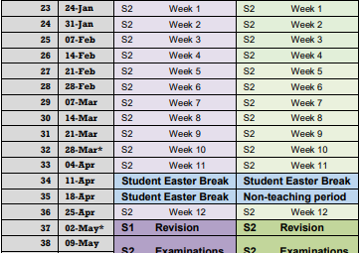
Semester 2

Slide 12
Programme
Week 1
Form teams
Choose roles
Week 2
Introduce the standard project
Introduce the development process

Slide 13
Programme
Week 3
Product development & features
Finalise groups and roles
Video profiles submitted
Week 4
Project Kick-off Sprint 1- MVP
Introduce the development process

Slide 14
Programme
Week 10
Submit Portfolio 1 (MVP)
Personal reports
Week 14
Submit Portfolio 2 (MMP)
Personal reports

Slide 15
Submissions
By week 3
Video Profile (Individual)
Group Proposal
Project Proposal (Optional)
By week 10
MVP Video
Contribution

Slide 16
Submissions
By week 3
Video Profile (Individual submission)
Group Proposal
Project Proposal (Optional)
By week 10
MVP Video
Contribution Report I (Individual submission)

Slide 17
Submissions
By week 14
MMP Video
Contribution Report II (Individual submission)

Slide 18
Submissions
Each week of the sprint Project manager submits a status report for the group.
Status
Ahead of schedule
On track
Behind schedule
Distressed

Slide 19
Next Steps
We shall discuss these topics each week.
We will update the advice based on feedback from you.
First step is to create your group!

Slide 20
Questions

